Slide 1

Sample Design:
No Company Logo,
No Mentor’s Name

Slide 2

Sample Design:
No Company Logo,
No Mentor’s Name

Slide 3
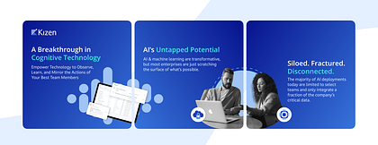
Sample Design:
No Company Logo,
No Mentor’s Name

Slide 4

Sample Design:
No Company Logo,
No Mentor’s Name

Slide 5
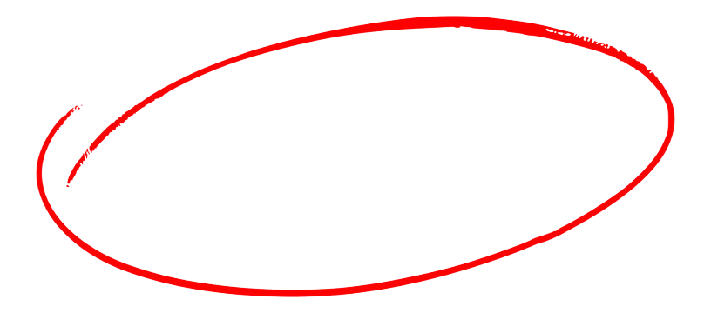
What are DAG, Jobs, Stages and Task in Spark Databricks?
Databricks Interview Question
Scroll right ====→

Slide 6
DAG: Spark uses a DAG (Directed Acyclic Graph) scheduler, which schedules stages of tasks. Represents the logical execution plan, showing task dependencies. The DAG scheduler optimizes execution by breaking operations into stages and minimizing data shuffling.
Jobs: A job in Spark refers to a sequence of transformations on data. Whenever an action like count(), first(), collect(), and save() is called on RDD (Resilient Distributed Datasets), a job is created. A job could be thought of as the total work that your Spark application needs to perform, broken down into a series of steps.
Scroll right ====→

Slide 7
Stages: A stage in Spark represents a sequence of transformations that can be executed in a single pass, i.e., without any shuffling of data. When a job is divided, it is split into stages. Each stage comprises tasks, and all the tasks within a stage perform the same computation.
Task: Each partition or core is equivalent to number of task. Tasks are where narrow transformations occur (e.g.,union(), map(), filter())
Scroll right ====→

Slide 8

Prepare yourself for average package of 15 LPA in
Data Engineering
Save this. Share it.
Follow for Data Engineering Interview Tips

